Slide 1
Belmayne ETNS Annual General Meeting 2013

Slide 2
Belmayne ETNS Annual General Meeting 2013
Agenda
Board of Management
Student Council
Principal Input
Literacy/ Numeracy Input
Ethics and Ethos
Parent Council
Launch Ceremony
Tea/ Coffee
PC Nominations
Cyber-Bullying Seminar

Slide 3
John
Chairperson, Board of Management

Slide 4
BETNS – Board of Management
4yr Term : Oct 2011 – Oct 2015

Slide 5
Tom – Patron Rep
Health and Safety Officer

Slide 6
Robbie – Community Rep
Treasurer

Slide 7
John – Patron Rep
Chairman

Slide 8
Tony – Parent Rep
Building

Slide 9
Sinead – Teacher Rep
Principal

Slide 10
Celine – Parent Rep
Parent Liaison

Slide 11
Gearóid – Teacher Rep

Slide 12
Aideen – Community Rep
Staff Liason

Slide 13
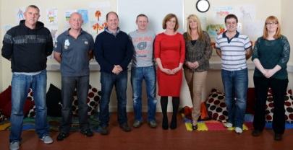
BOM - What do we do ?
In School Management Team (ISM)
Parent Council
Child
Parents
Student Council
Staff

Slide 14
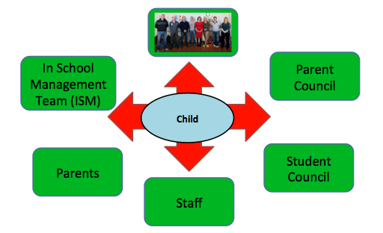
BOM - What do we do ?
Educate Together
Department Of Education
School Inspections
SENO’s
Legislation
Ombudsman
Child Protection
NEWB – School Attendance
School Completion

Slide 15
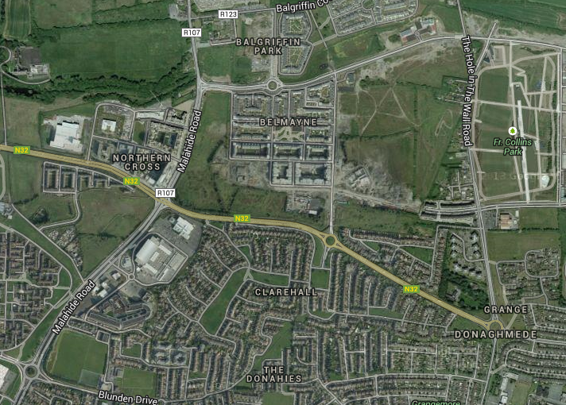
BOM - What do we do ?

Slide 16
BOM - What do we do ?
New Building
Prefabs
Interviews
Child protection
Ombudsman

Slide 17
School Finances

Slide 20
Anastasiya
President, Student Council

Slide 21
Sinéad
Principal

Slide 22
Principal’s Role
Day to day manager of the school. Answerable in these decisions to the BOM, Inspectorate/ET and Dept. of Education
Ensure staff plan effectively and are implementing all curricular areas
Ensure day to day running off the school for teaching, applications for staffing, maintenance, finances and communication is in place. Engage in employment and manage teaching staff, ancillary staff and afterschool
Ensure staff meetings, ISM meetings, BOM and planning occurs.
Liaise with and support children and parents, ensuring each has a voice and events are put in place.
Attending training and linking in with agencies such as Dept. of Ed, ET,NEPS/SCP/HSE-Social Services/Child Professional Services.
Ensure child protection and safety is in place.
Ensure BOM and Inspectorate are informed regularly of all successes, changes and issues in the school.

Slide 23
2008/2009
2008- 2 Teachers and 9 children.
Priorities were to keep the school open!
2009- A core group of staff and parents were established who had a strong involvment of the development of Belmayne ETNS
Staff- Viv Dee Gearóid, Joe and Elaine (SNA)
Five year DEIS plan . At this stage we had 60 children, very little teaching resources and while other ET schools were oversubscribed, there was little known regarding Belmayne ETNS.

Slide 24
5 Year Plan
To increase enrolments.
Irish to be used as an informal language.
Children with special needs would be integrated and appropriate supports would be in place.
Targeted team teaching would be put in place in Literacy/Numeracy and that the success would be reflected in Government testing.

Slide 25
5 Year Plan
To inform the Department of growing enrolments in order to secure a new school building.
To ensure we continued to develop a core group of positive parents who would advocate on behalf of the parents body and continue to be supportive of staff in the school.
To develop the school’s ethos and involve parents.

Slide 26
5 Year Plan
To develop a strong in school management team(ISM) and to continue to keep the level of staff commitment as the school progressed.
To increase all resources and annually to provide IT supports in order for class teaching to be interactive.
Establish a working Board of Management where each member has a specific role and inputs and supports the BOM with that role.

Slide 27
2013
Principal's Survey- Staff asked to look at different areas and comment on the successes/challenges in each area-PC/Parent Body/Support Staff/Resources/BOM etc.,
2 Main assets in the school are parents and staff.
Staffing - One secretary, 3 SNA’s, 16 full time teachers and one Resource teacher 3days per week, HSCL 2 days per week.
Procedure for Selection of Staff.
Enthusiastic/caring /work after hours/attend events and put huge work into planning for our children.
Eager to attend training.
Work outside their own class role

Slide 28
Our Staff
Other staff drive roles…examples
Science Day - Fiona, Karl and Paula
IT - Paula/Viv
Sports Day - Karl/Joe
Maths Week - Paul,
GAA – Gearoid, Becky, Paula and Karl
Green School - Sarah, Joe and Denise,
Athletics - Dee
Christine is driving the Xmas Performance,
Sarah and Aoife - Art,
Johanne - Ground Maintenance/Previous ISM Holder
Rainbows – Paula, Niamh and Eoghan,
Mel - Special Ed Liaison

Slide 29
Parents
What we can do with your support:
Walks/school trips/Art Days/Science Days and Competitions/ Open Days/Sport Days/Ethics Inputs/Faith Formation Classes/Cake Sales/Family Food Fair/Xmas Plays/Maths and Numeracy Initiatives such as Maths for Fun, Literacy for Fun Programmes, Story Sacks Project, the purchase of resources….and most importantly we get to know you and your family in a positive way!
What parents attend in our school-
Book Club/Coffee Mornings/English, Irish classes/Art Classes/ Mindfulness/Parent Plus

Slide 30
What’s next?
Continue what we are doing !
Digital School ratio of 1:9 computers
Self Evaluation
Reviewing of Polices and Implementing new Anti Bullying Policy
Dissolving Boundaries through IT-linked with a school in Belfast
Sport-include swimming /rugby -continue with GAA etc.,
End of year that building will be in a position where they are ready to go on site
New PC!

Slide 31
Team Teaching
All teachers differentiate.
Team Teaching- All classes from Senior Infants to Sixth Class will receive 2 Literacy and 2 numeracy Team Teaching Sessions a week. Each session will last approximately 35 minutes.

Slide 32
Gearóid
Teacher, Literacy/ Numeracy Co-Ordinator

Slide 33
Standardised Test Results 2013
Belmayne Educate Together

Slide 34
MICRA-T & SIGMA-T National Distribution
Extremely Low | Low | Low Average | High Average | High | Extremely High

Slide 35
MICRA-T & SIGMA-T National Distribution
Extremely Low | Low | Low Average | High Average | High | Extremely High

Slide 36
MICRA-T Results 2013

Slide 37
MICRA-T Scores in Belmayne ETNS compared to the National Average
School – Blue
National Distribution – Red
Extremely Low | Low | Low Average | High Average | High | Extremely High

Slide 38
MICRA-T Scores in Belmayne ETNS compared to the National Average
 | Extremely Low | Low | Low Average | High Average | High | Extremely High
National Distribution | 2% | 14% | 34% | 34% | 14% | 2%

Slide 39
MICRA-T Scores in Belmayne ETNS compared to the National Average
 | Extremely Low | Low | Low Average | High Average | High | Extremely High
National Distribution | 2% | 14% | 34% | 34% | 14% | 2%
School Objective: To score lower than National Distribution
School Objective: To score higher than National Distribution

Slide 40
MICRA-T Scores in Belmayne ETNS compared to the National Average
 | Extremely Low | Low | Low Average | High Average | High | Extremely High
National Distribution | 2% | 14% | 34% | 34% | 14% | 2%
School Distribution | 0% | 12% | 29% | 40% | 15% | 4%
School Objective: To score lower than National Distribution
School Objective: To score higher than National Distribution

Slide 41
MICRA-T Scores in Belmayne ETNS compared to the National Average
School – Blue
National Distribution – Red
Extremely Low | Low | Low Average | High Average | High | Extremely High

Slide 42
SIGMA-T Results 2013

Slide 43
SIGMA-T Scores in Belmayne ETNS compared to the National Average
Belmayne ET
National Average
Extremely Low | Low | Low Average | High Average | High | Extremely High

Slide 44
SIGMA-T Scores in Belmayne ETNS compared to the National Average
 | Extremely Low | Low | Low Average | High Average | High | Extremely High
National Distribution | 2% | 14% | 34% | 34% | 14% | 2%
School Objective: To score lower than National Distribution
School Objective: To score higher than National Distribution
School Objective: To score lower than National Distribution

Slide 45
SIGMA-T Scores in Belmayne ETNS compared to the National Average
 | Extremely Low | Low | Low Average | High Average | High | Extremely High
National Distribution | 2% | 14% | 34% | 34% | 14% | 2%
School Distribution | 1% | 8% | 28% | 39% | 22% | 2%
School Objective: To score lower than National Distribution
School Objective: To score higher than National Distribution
School Objective: To score lower than National Distribution
School Objective: To score higher than National Distribution

Slide 46
SIGMA-T Scores in Belmayne ETNS compared to the National Average
Belmayne ET
National Average
Extremely Low | Low | Low Average | High Average | High | Extremely High

Slide 47
Fiona
Vice-Principal, Learn Together Co-Ordinator

Slide 48
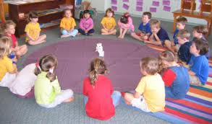
Belief Systems
Moral and Spiritual
Learn Together Curriculum
Ethics and Environment
Equality and Justice

Slide 49
Morality and Spirituality
Golden rules of our school
Create class rules collaboratively
Moral dilemmas appropriate to class level
Relaxation, quiet reflection time
Remembrance day
Thinking Time
Circle Time

Slide 50
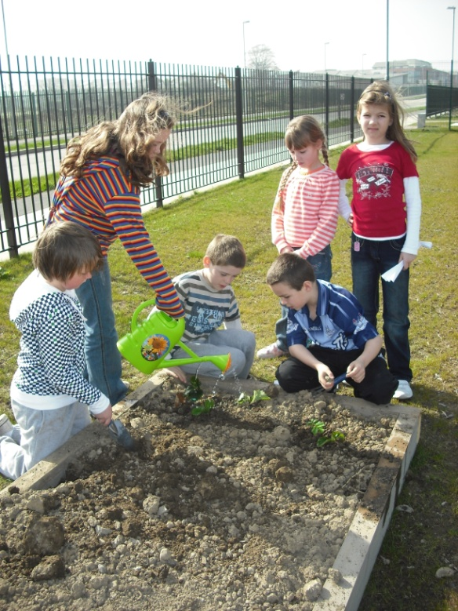
Ethics and the Environment
Green Flag Activities/Green School Committee
Recycling Week
Green Schools Action Day
Earth Day
School Garden
Planting
Harvesting
Tree Week
Chickens

Slide 51
Equality and Justice
Conflict Resolution
Rights of the Child
Human Rights Day
Fair Trade Fortnight
Friendship Week
Student Council activities
School visit from Amnesty Intl.
Knitting bus- Age Action
Childfund

Slide 52
Belief Systems Example
Year 1 2013/2014 | Year 2 2014/2015
Christianity | Judaism
Islam | Hinduism
Buddism | Sihkism
Atheism & Paganism | Other Belief Systems

Slide 53
Islam | September | School rules(MS, EJ) Project Positivity (MS, EJ,EE) Student council elections- democracy (EJ,EE) Green school stuff(EE)
Islam | October | Harvest (B, EE) festivals(http://www.harvestfestivals.net/harvestfestivals.htm Trees(EE)
Islam | November | Death/Remembrance/ Giving Thanks(MS)
Christianity Buddism Islam | December | Festivals of light (Advent,diwali,Santa Lucia ,etc (MS, B) http://www.everythingesl.net/lessons/light_festivals.php Quiet reflection time (MS)
Christianity | January | Human Rights(EJ, EE, ) Respect (MS, EJ,EE) Media awareness(EJ,EE,)

Slide 54
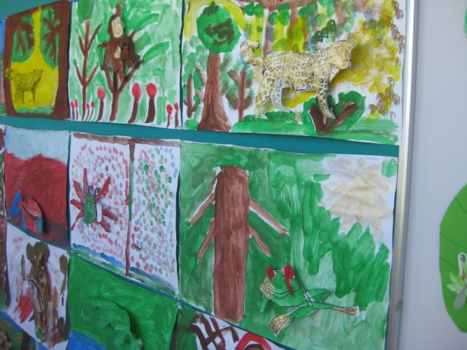
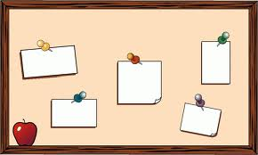
Scrap Book for every child
Learn Together
Whole School Displays
Website and blogs
Music and Songs
Notice Board

Slide 55
Learn Together Curriculum
Learning Together to Live Together
Parents/Community involvement
The way we communicate

Slide 56
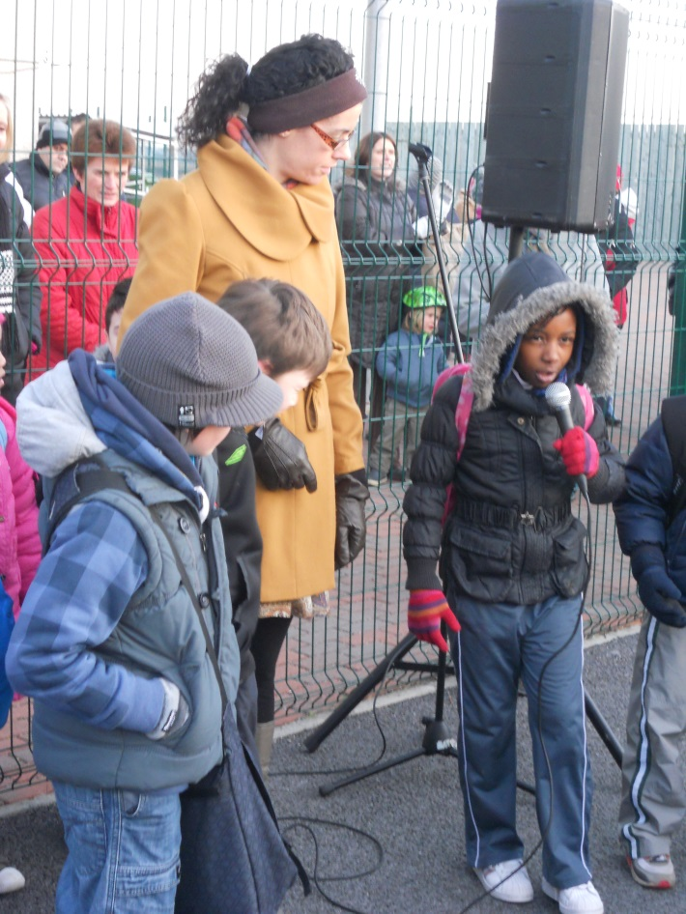
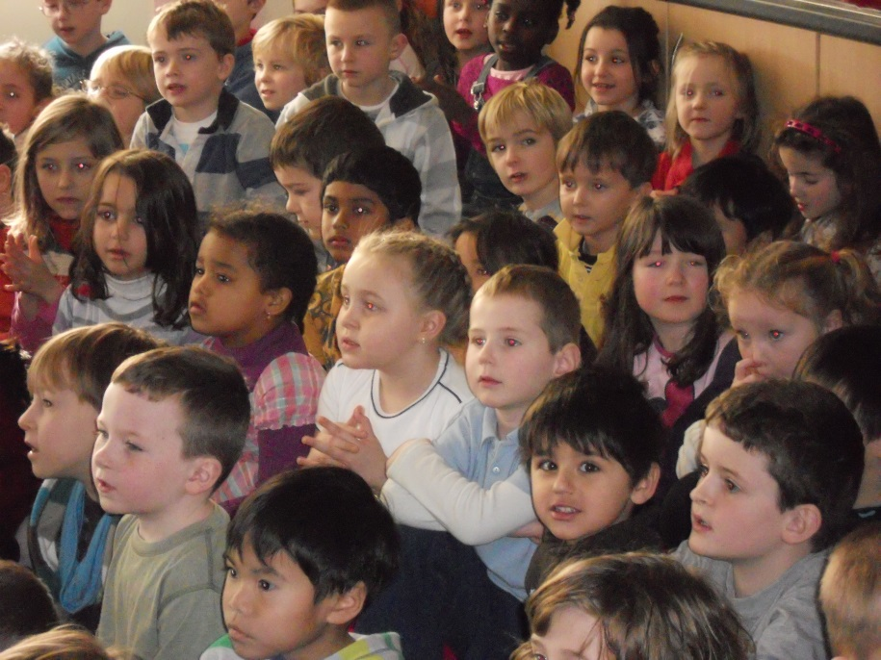
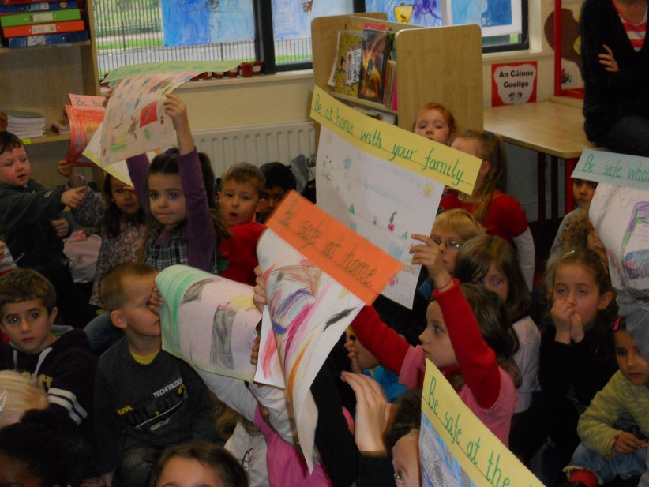
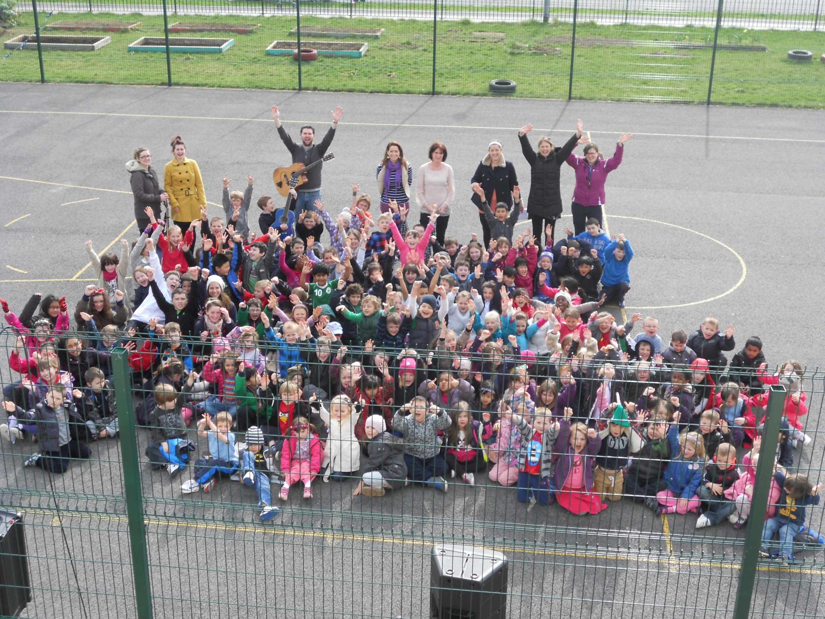
Assemblies

Slide 57
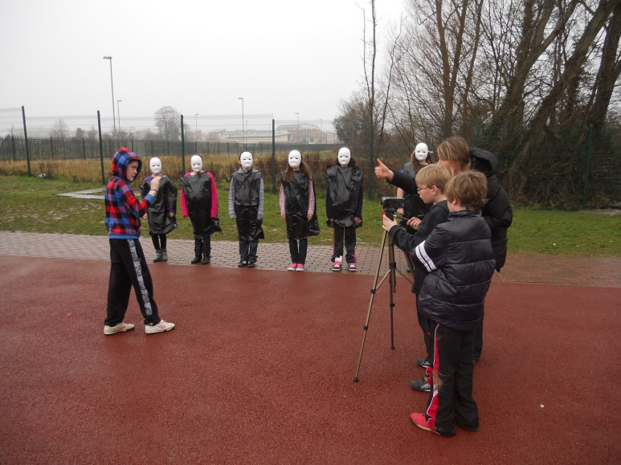
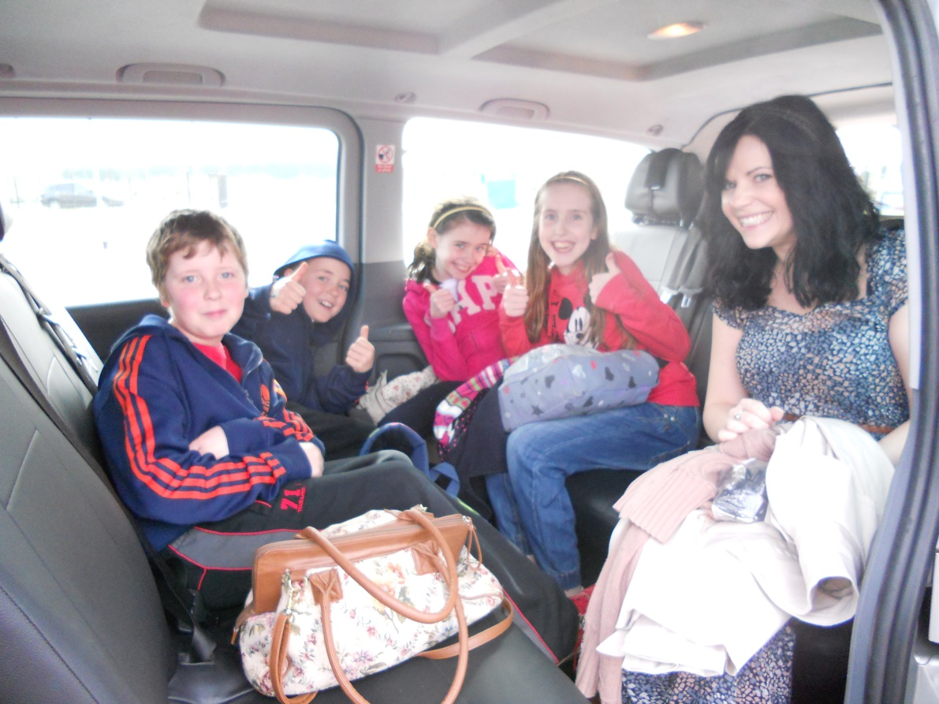
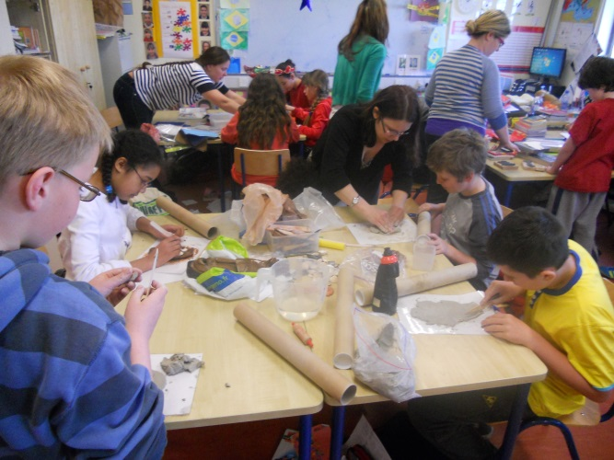
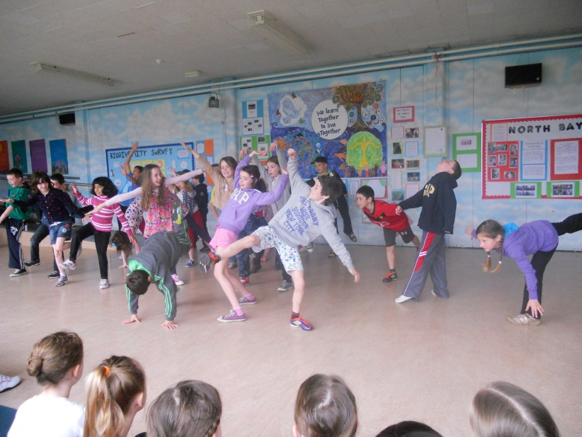
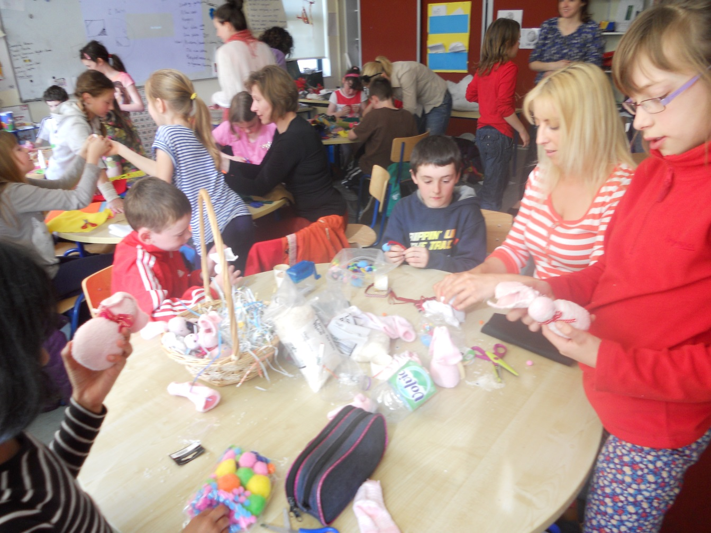
Film making
Anti- racism
Projects
Dance
Craft

Slide 58
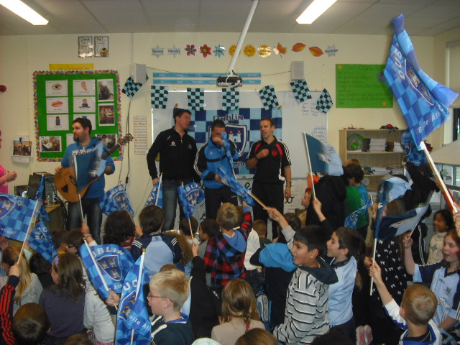
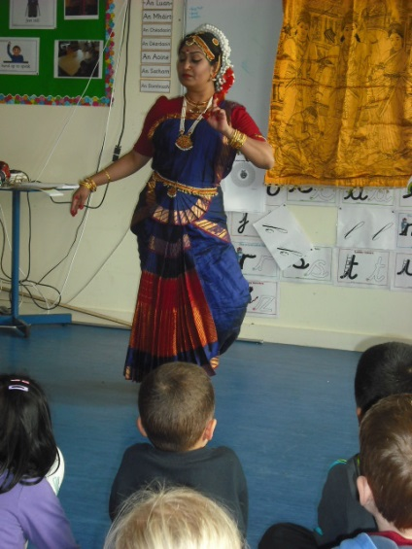
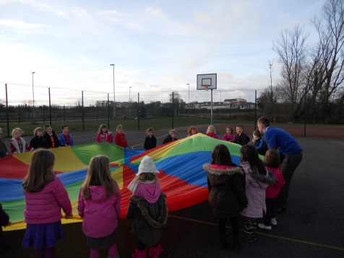
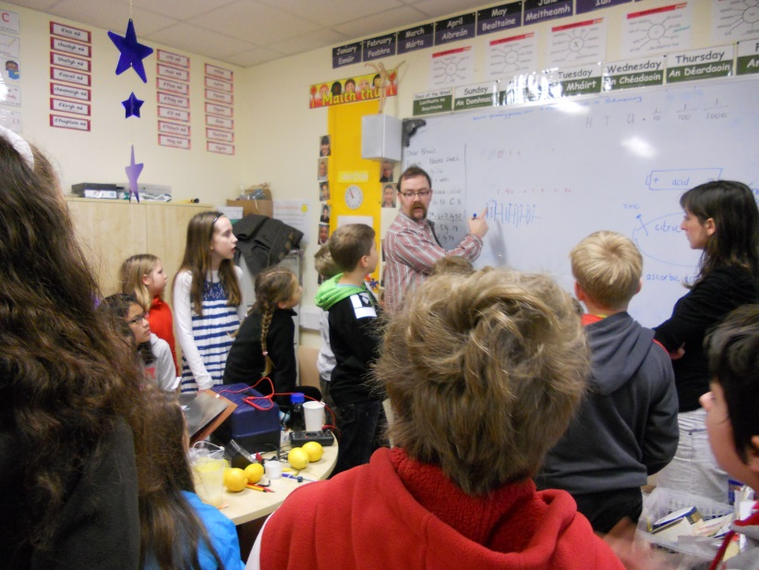
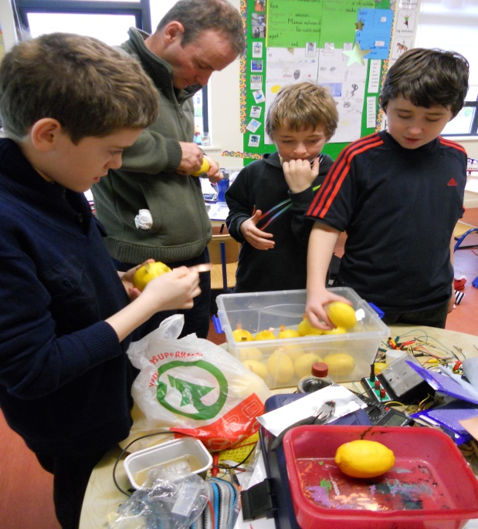
Identity
Culture
Working
together
Questioning

Slide 59
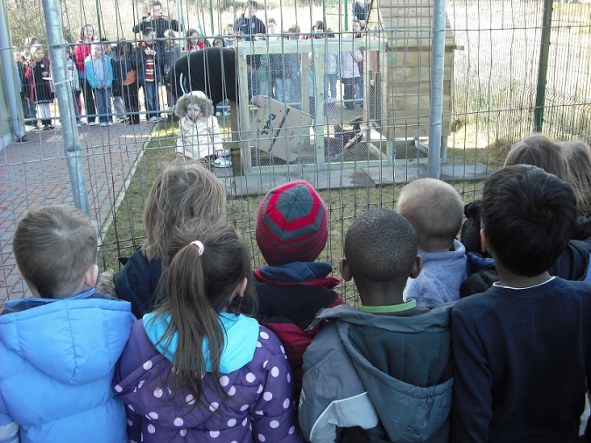
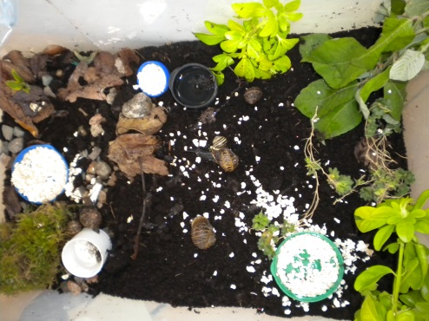
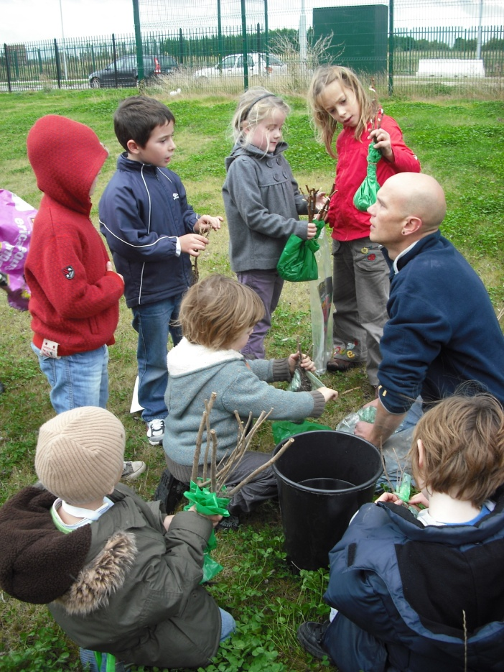
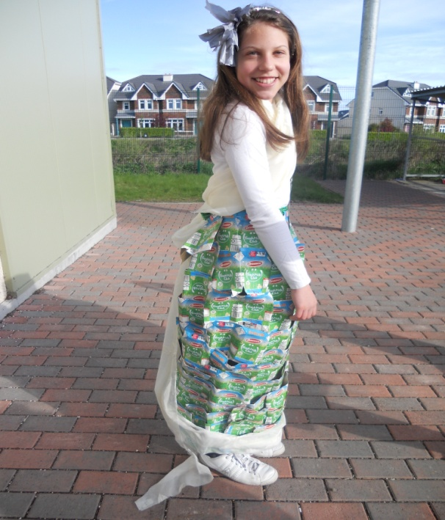
Chickens!
Environmental care
Green Flag
Garden club

Slide 60
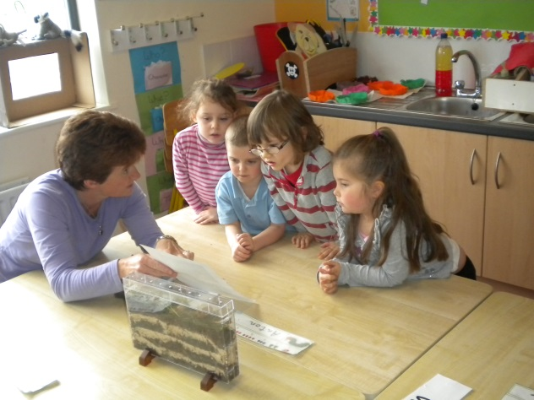
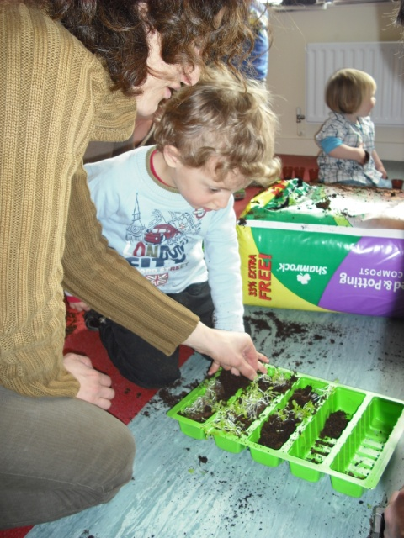
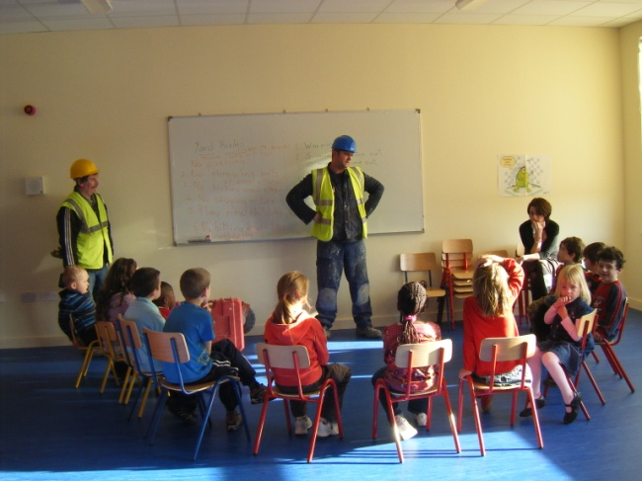
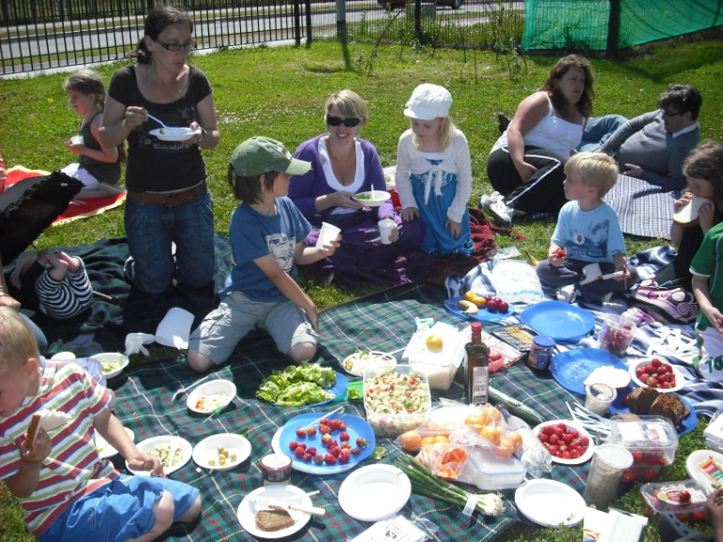
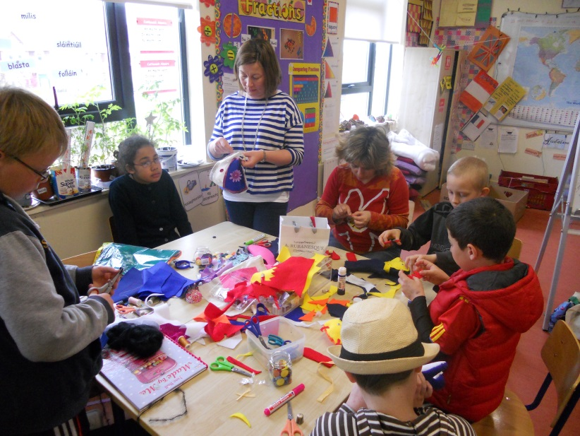
Parents

Slide 61
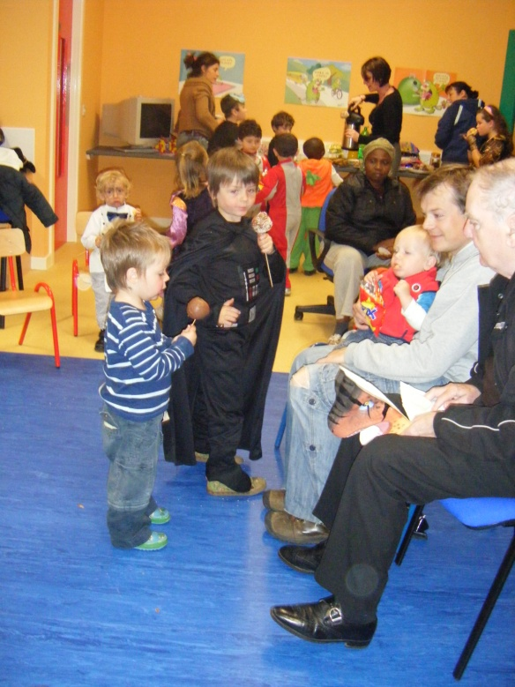
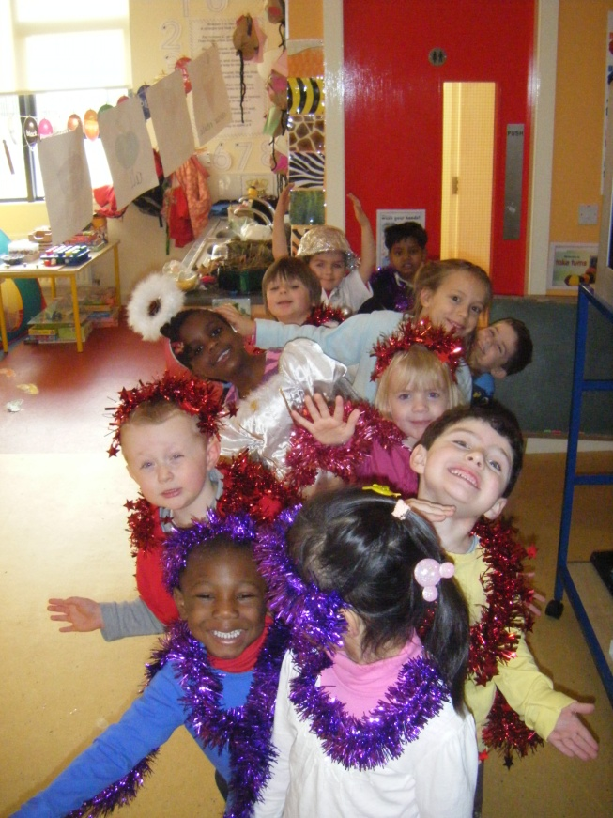
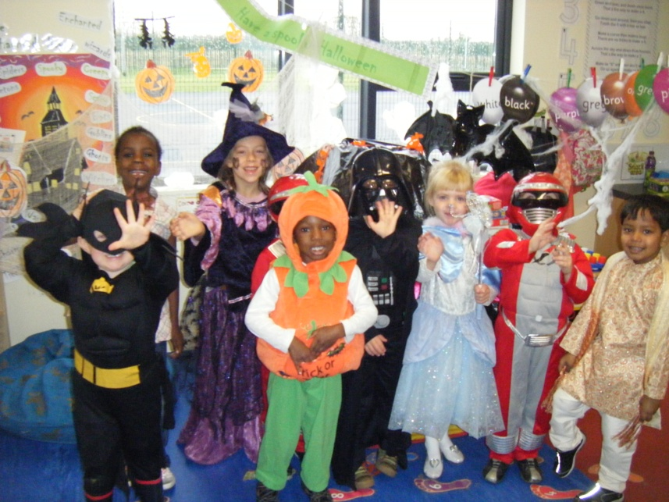
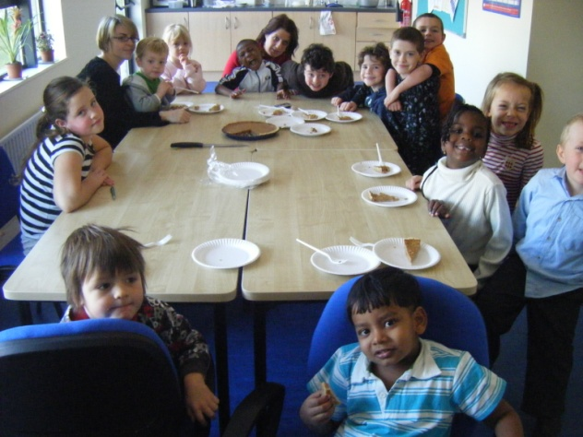
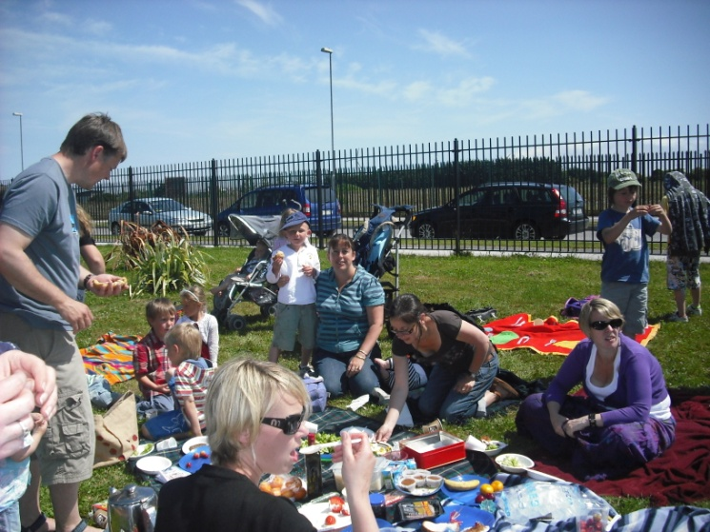
Celebrations

Slide 62
Maedhbh
Chairperson, Parent Council

Slide 63
What is the Parents Council’s role in the school?
The Parents Council is the structure through which the parents within our school can work together for the best possible education for our children
The Parents Council works with the principle, staff and the Board of Management to build effective partnership between home and school.

Slide 64
The Last Year
The National Parents Council Primary
An evening of input from Tom Green
Policies
Developing our constitution
Envelope Day
Family Food Fair
Open Day
Coffee mornings for our new parents

Slide 65
As a Parents Council through some of the Fund raising done we have purchased
resources such as books,
maths equipment,
the two interactive white boards for the prefabs
the flag pole for our green flag.
Student Council - we have also helped out the student council with cake sales, movie nights and their disco.

Slide 66
None of which could have been done without the generosity and help of you, the parents
Thank You!

Slide 67
Paula
Teacher, IT Co-Ordinator

Slide 68
Welcome to the Official Launch of the Belmayne ETNS App!

Slide 70
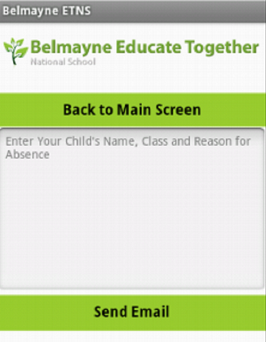

Slide 72
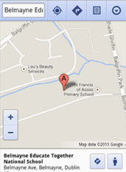

Slide 73
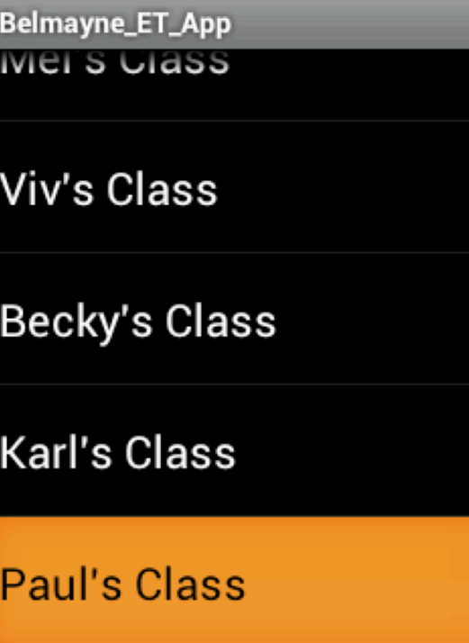

Slide 74
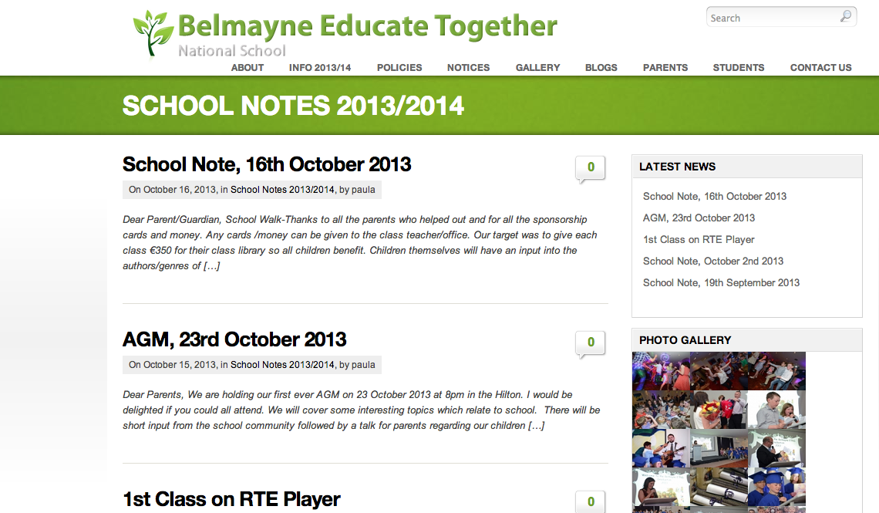

Slide 75
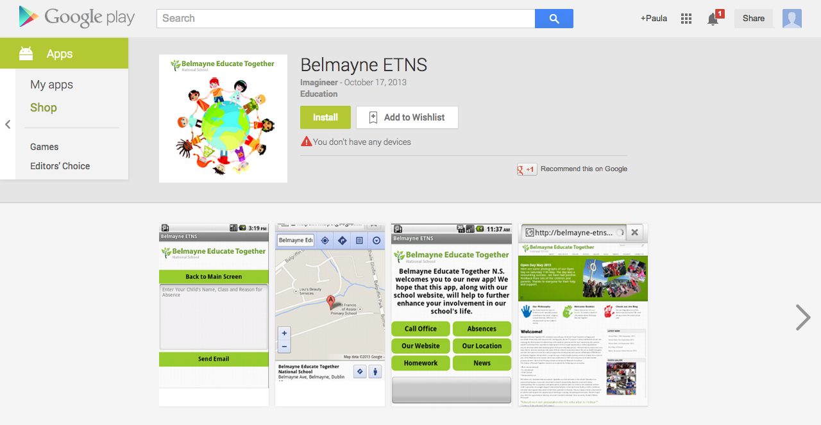
Where can you get it?
Google Play Store
Amazon Store

Slide 76
What can use this App?
Any Android smartphone – Samsung Galaxy, HTC etc.,
Kindle Fire

